Slide 1


Asynchronous programming in Python
async/await

Slide 2
Index
What is blocking IO?
What is asynchronous programming
Python Asynchronous programming: async / await
Drawbacks

Slide 3
Who am I? Héctor Álvarez
Github https://github.com/monobot/
Linkedin https://www.linkedin.com/in/hector-alvarez/
Twitter https://twitter.com/monobotBlog
Email hector.alvarez@ebury.com

Slide 4
What is blocking IO?

Slide 5
What is blocking IO?
When your execution process is waiting for some external resource response
What can you do to avoid it?
    Usually create a task (like queues or celery)
    Start a thread (oh my GIL)

Slide 6
How do Operating Systems manage multitasking?
In computing, multitasking is the concurrent execution of multiple tasks (also known as processes) over a certain period of time. New tasks can interrupt already started ones before they finish, instead of waiting for them to end. (computer multitasking)
If you think a bit, asynchronous programming sounds a lot like that.

Slide 7
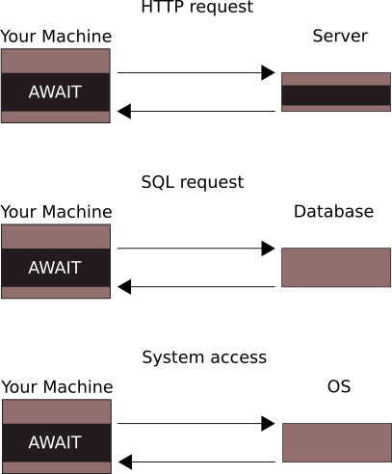
What is blocking IO?

Slide 8

What is REALLY a blocking IO? (or worse scenarios)

Slide 9
What is Asynchronous programming?

Slide 10
What is Asynchronous programming?
Asynchronous programming is when you programmatically specify when execution time can be transferred to other tasks and come back to this one once the call back has been triggered.
The most difficult part is know those moments and what to do in those cases.

Slide 11
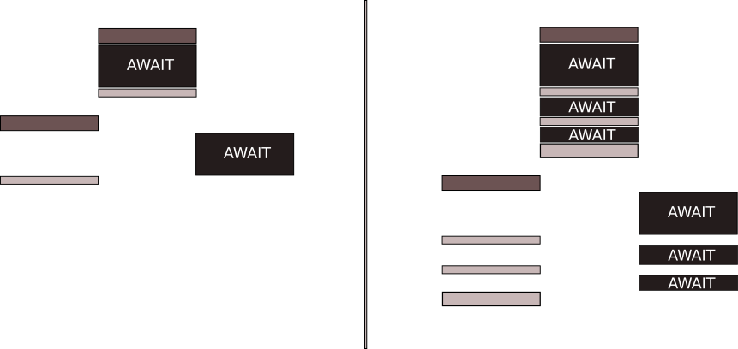
What is Asynchronous programming? (task dissection)

Slide 12
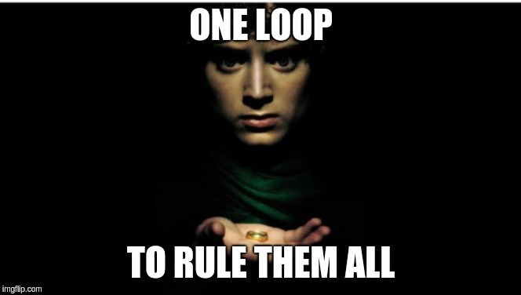
What is Asynchronous programming?

Slide 13
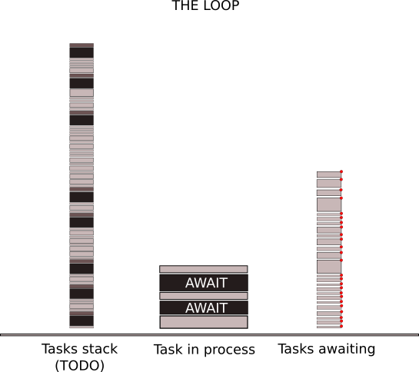
What is Asynchronous programming?
The event loop is in charge of everything.
Keeps state of all the different tasks and manage the callbacks.

Slide 14

What is Asynchronous programming?

Slide 15
Python Asynchronous programming: async/await

Slide 16
Python Asynchronous programming: async/await
Since python3.3 you can do asynchronous programming in python, when they incorporated the library named asyncio to the python stack.
But by then we had weird notations like @asyncio.coroutine and yield from to define the coroutines and when to await for IO.
Its not until python v3.5 that we have the new reserved words async / await

Slide 17
Python Asynchronous programming: async
When a function or method is defined with async, its then a coroutine.
Coroutines can only be managed by an event loop, you can not run them outside them (but there are tricks).
But loops can run non coroutines, but since the await will not be defined they will be run until completed.

Slide 18
Python Asynchronous programming: await
Await reserved word can only be used inside a coroutine, a coroutine can have any number of awaits inside, each of them will be handled with their own callback.

Slide 19
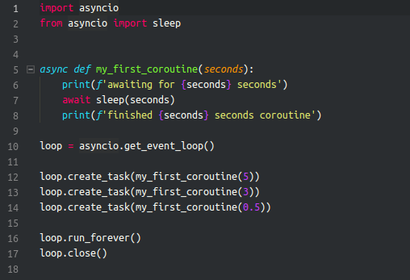
Python Asynchronous programming: first coroutine
define a coroutine:
async
To use a coroutine:
await
and inside a loop

Slide 20
Python Asynchronous programming: the loop
Considerations about the loop
Running the loop
get_event_loop
get_running_loop
set_event_loop
new_event_loop
run_until_complete
run_forever
stop
is_closed
close

Slide 21
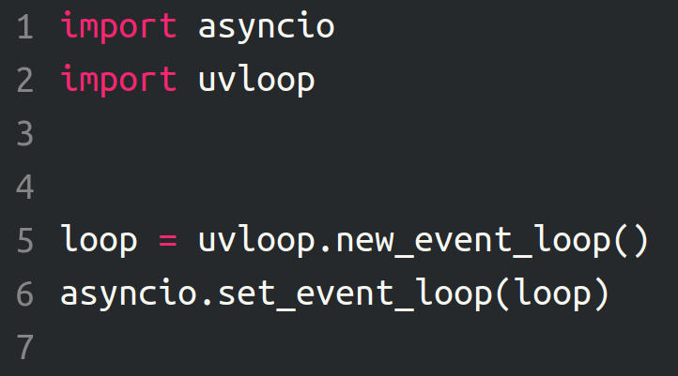
Python Asynchronous programming: the loop
Special mention: uvloop

Slide 22
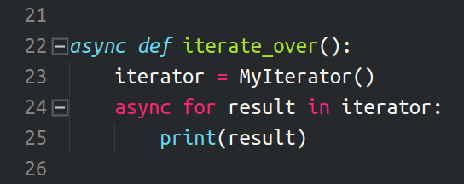
Python Asynchronous programming: iterators
But its not only async/await, you would also need new way to work with iterators, so on each iteration on it should be awaited:
How do you iterate over them?

Slide 23
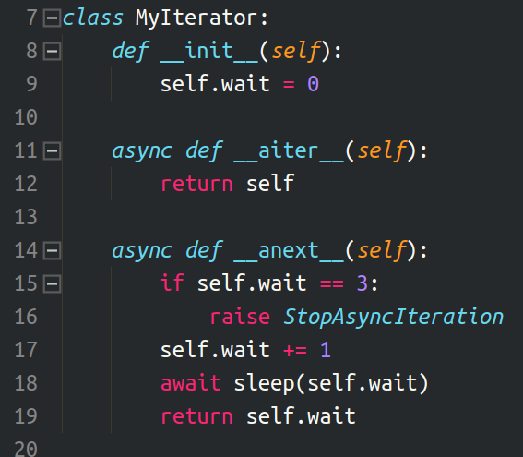
Python Asynchronous programming: iterators

Slide 24
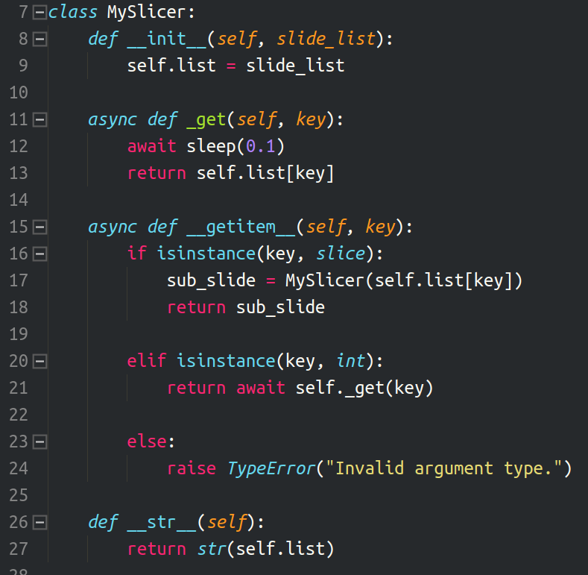
Python Asynchronous programming: slices

Slide 25
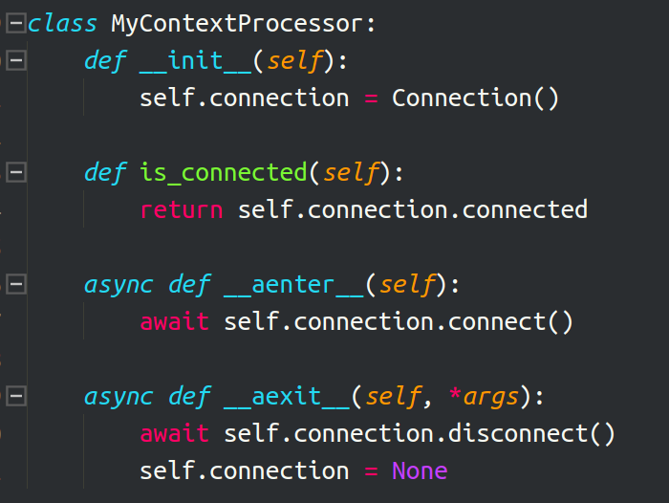

Python Asynchronous programming: context processors

Slide 26
Python Asynchronous programming: queues
AsyncIO is very big, like everything in python comes with batteries included.
You have Queues, so you can enqueue task that would be eventually consumed.
like so:

Slide 27
Python Asynchronous programming: Drawbacks

Slide 28
Python Asynchronous programming: Drawbacks
Asynchronous programming has some learning curve.
    You have to know what and when to apply coroutines (interpreter will of course complain)
Debug asyncIO IS difficult
    Even when execution process is not linear, execution has linear logic, you know step by step what happen in your program next but not when that will happen.
    Last EuroPython Yuri advanced that ids and id inheritances are coming in python3.8 (But I still can not find them, you can name tasks tho)
Changes to AsyncIo API are expected.
    Maybe not big changes, bit improvements and such.

Slide 29
Python Asynchronous programming: Resources
This presentation code will be available in github
Python’s documentation asyncIO
Hear Yuri talk about the future of asyncIO in 3.7 3.8 and ahead.
Python async frameworks
    Trio
    Curio
Python async web frameworks
    Tornado
    Sanic

Slide 30

Thanks !

